Slide 1


Social Media posts
by Summit Agility

Slide 2


Slide 3


Slide 4
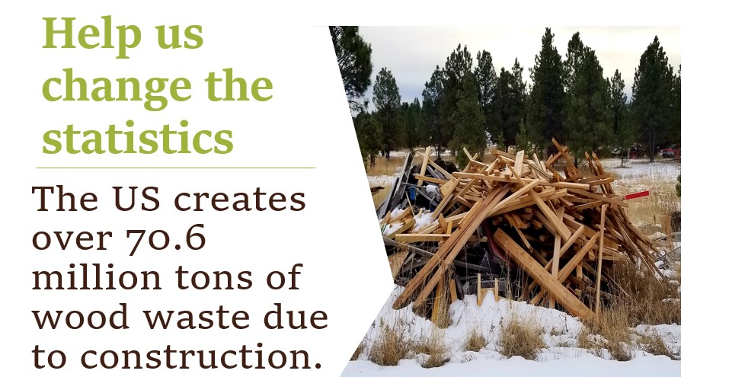

Slide 5


Slide 6



Slide 7


Slide 8



Slide 9



Slide 10
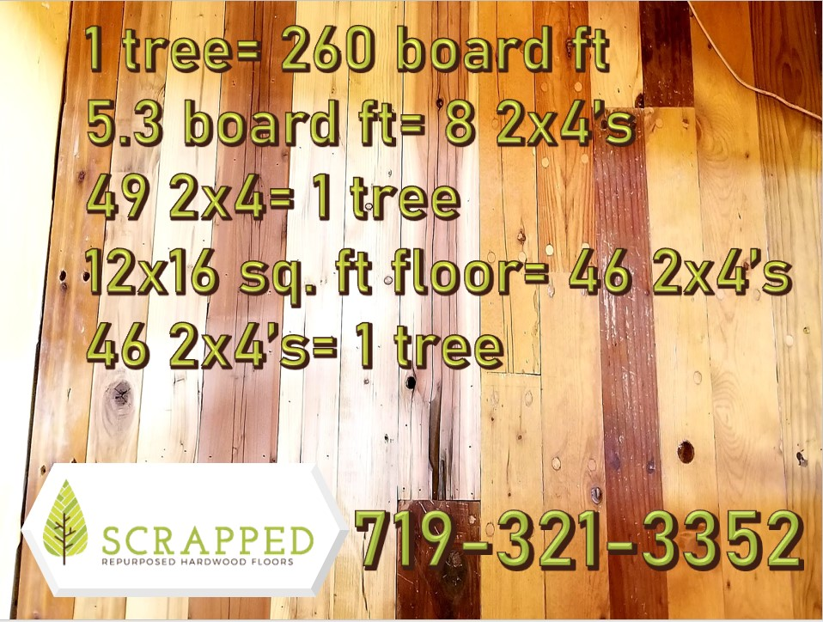


Slide 11


Slide 12
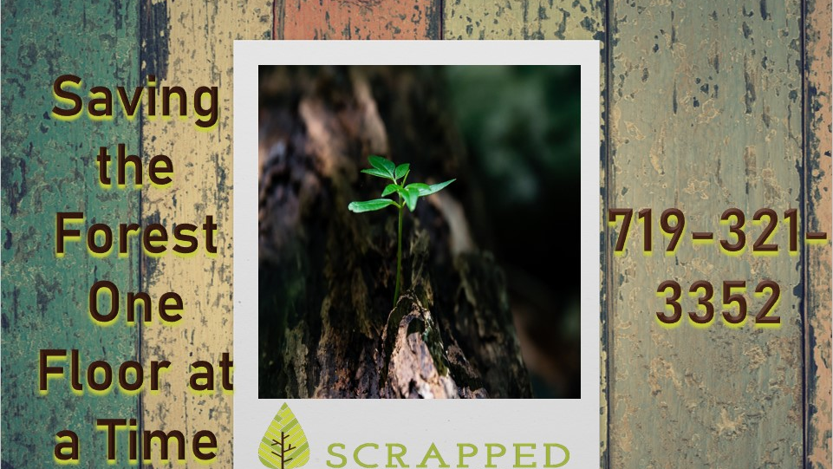





Slide 13


Slide 14


Slide 15


